Slide 1
Atlanta Holochain Meetup 1/10/2018
What does it mean to be digitally sovereign?

Slide 2
Why Digital Sovereignty Collective ?
Aims to provide a forum for diverse individuals from the tech, arts, food, and social justice spheres to converge and discuss how decentralized p2p tech can facilitate the emergence of grassroots economic alternatives.
To decentralize power and weaken the hold of the tech monopolies Facebook, Google, Amazon, & Apple.
To facilitate individual & collective sovereignty over our own data. (i.e. control over who has access to it and for what purposes, and the capacity to use our own data for the empowerment of our own communities)
To enable cross-sector collaboration between community organizers, developers, and academics, so that our our tech matches the needs of the people its intended to serve.
We see the accelerating change and adoption of technology to be happening on an evolutionary scale and we are here now to help facilitate the transition into a reality where the natural, spiritual and digital are in resonance and work together to manifest a diverse and resilient ecosystem of democratically-governed peoples.
Founders:
Micah
Sophia

Slide 3
Holochain Community’s Purpose
“In a period that is getting more volatile, uncertain, complex and ambiguous, humanity is facing enormous challenges as a species. We need to level up our game in terms of our ability to adapt and coordinate if we are going to succeed in facing those challenges.
Holochain’s ambition: to bring humanity's capacity for coordination to a whole new level. In our view, that requires all sorts of new bottom-up coordination patterns -- patterns that are opted into, and more importantly renewed through ongoing use -- by the participants themselves. We see this as nature's preferred pattern for collaboration at a biological level. Making use of that same pattern at a social level will enable individuals and communities to be more responsive to shifting challenges and opportunities.” [Matt Schutte]

Slide 4
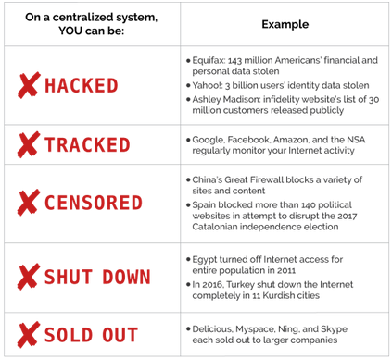
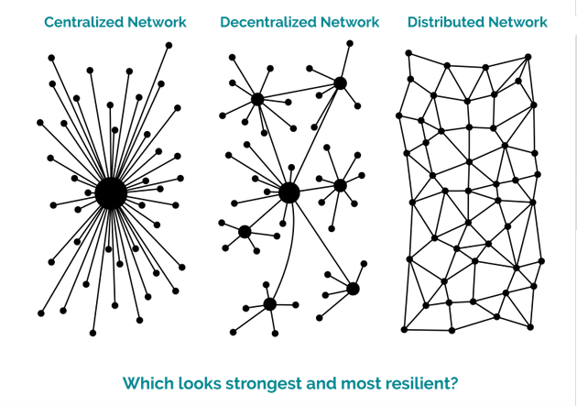
Issues with Centralized Systems

Slide 5
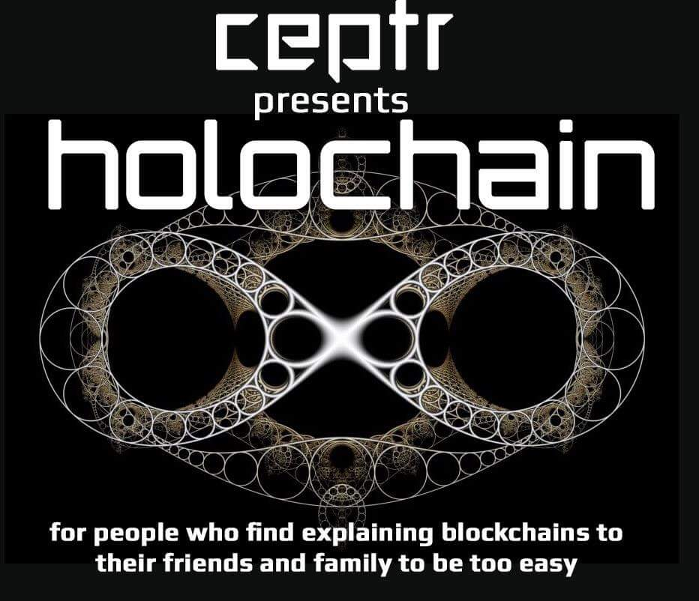
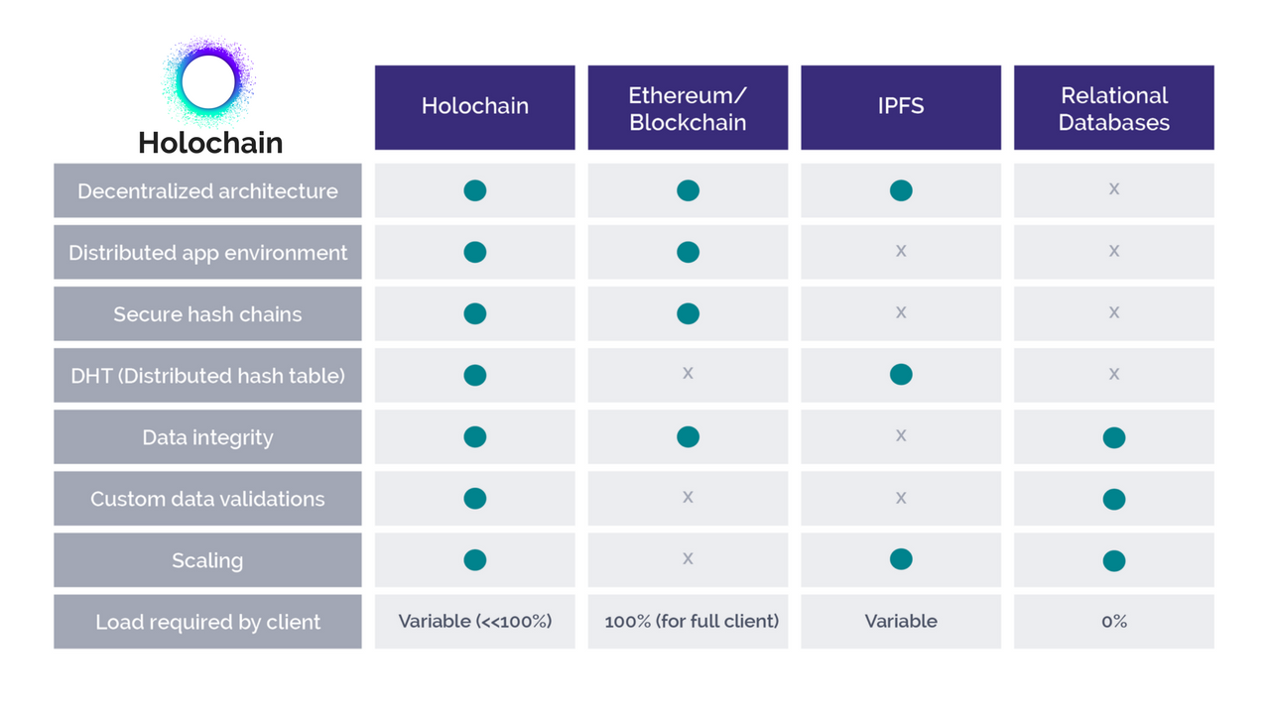
Holochain vs Blockchain
Notes:
Blockchain: Data-centric, a single global data set - one shared reality across all nodes.
Holochain: Agent-centric, allows nodes to act independently, or in tight coordination only with counterparties, and then share independently evolving data realities that come to agreement over time.

Slide 6
Holochain vs Blockchain
Notes:
Blockchain: Data-centric, a single global data set - one shared reality across all nodes.
Holochain: Agent-centric, allows nodes to act independently, or in tight coordination only with counterparties, and then share independently evolving data realities that come to agreement over time.

Slide 7
Holochain vs Blockchain
 | Current System | Blockchain | Holochain
Security/Trust | Database held “securely” by third party | Distributed Global Ledger of “Indisputable Truth” | Community-set rules to play by + social accountability
Governance | Oligarchy | “Consensus” & Smart Contracts | Pluralistic commons
Model | Dominance | Liberty | Holographic Coordination (Biomimicry)
Ontology | Corporation-centric | Token-centric | Agent-centric
Example (Jamie Klinger) | A centralized app like Snapchat offers you a small file (the app) to download that sends data through centralized servers. | A decentralized app like TenX runs on a decentralized blockchain (Ethereum). | A decentralized app like TenX runs on a decentralized blockchain (Ethereum).
“Blockchain is about managing a consensus about what was “said.” Holochain is about distributing a consensus about how to “speak” [Art Brock]

Slide 8
Examples in Nature
Human Language
We are a speaker of a language when we know how to use the rules of that language properly
We don’t have to know all the same words (because we can use the rules to explain unknown ones)
We don’t need to have the same experiences
We certainly don’t need some global ledger of everything that’s ever been said, or require consensus about what has been said
Yet there are infinite possibilities for how we may communicate with one another within the boundaries of this language.
Cells
each cell carries a copy of their rules or instruction set (i.e. DNA)
there is no global ledger about the state of trillions of cells
Yet, our cells coordinate in a highly decentralized manner, without the latency or bottlenecks of central control

Slide 9
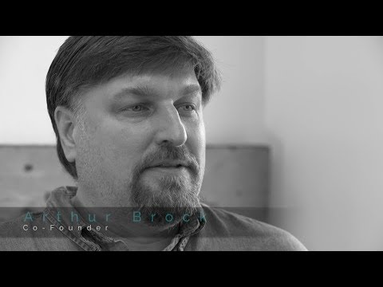
Holochain vs Blockchain

Slide 10
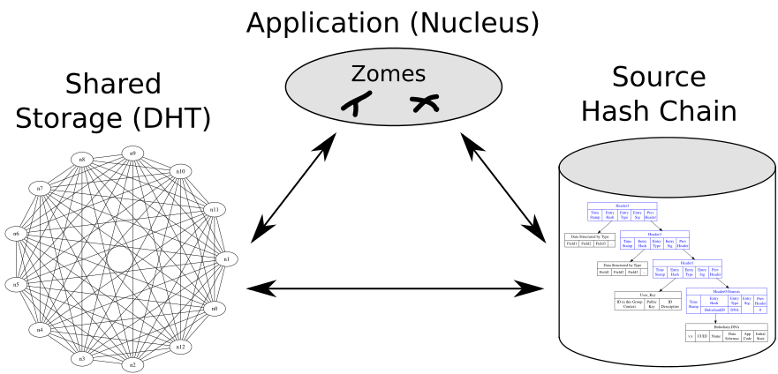
Overview of Holochain Architecture

Slide 11

Overview of Holochain Architecture
What are D.H.Ts ?

Slide 12
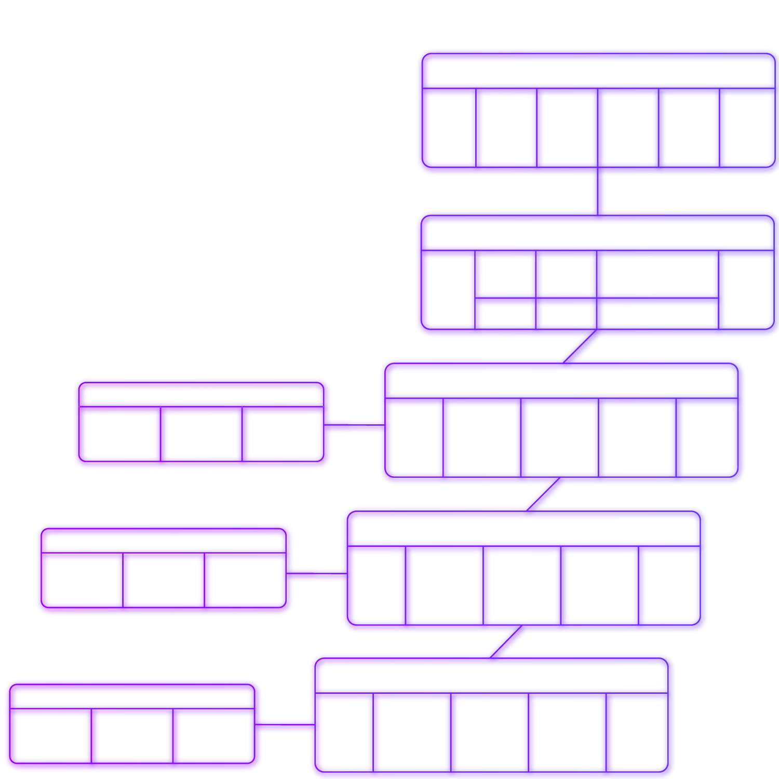
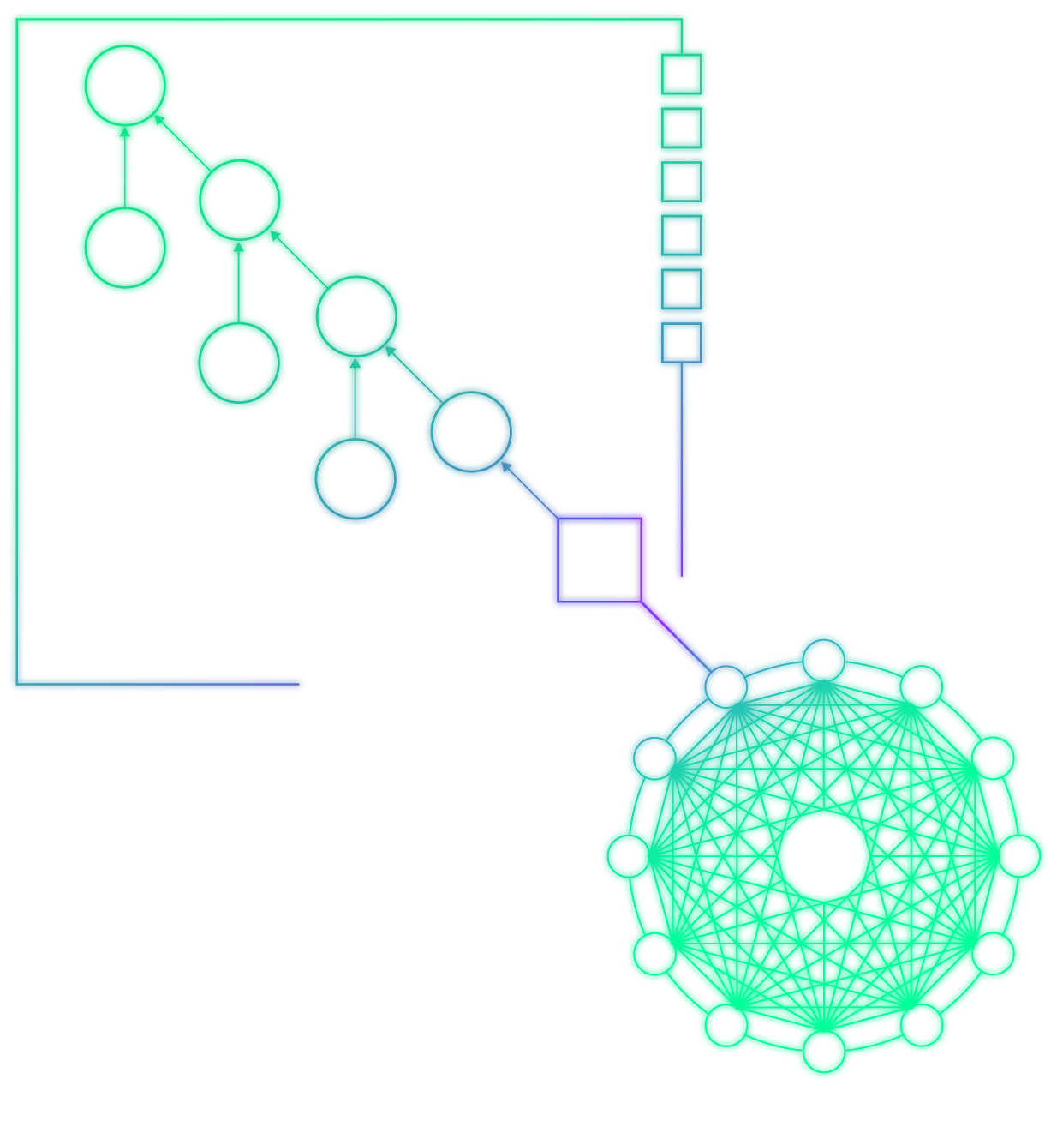
Overview of Holochain Architecture
Notes:
Distributed Hash Tables (DHTs) are already used for file sharing (bittorrent) and other widespread applications. In these systems, the data is content addressable by cryptographic hash, so you can confirm you receive unaltered data by hashing it yourself. In our validating DHT, we confirm the provenance of every piece of data, validating the signature of its author, and that it has been committed to their local chain. Multi-party transactions create a “crossing” of chains which also assure that even if you try to alter your own chain, your transaction is published by others. Our DHT also has an unusual feature which allows meta-data to be put on data in the DHT which can be used to publish information about a person/node (such as their transactions, or top of their hashchain) or data element (such as tags, comments, or ratings). Just like validation rules on blockchain nodes, if someone hacked their code to behave differently, even if they colluded with others, the rest of the nodes on the DHT would not validate their altered behavior and they will have essentially just forked themselves out of being able to participate on that holochain.

Slide 13
Holochain vs Holo
Architecture vs Application
Accessibility to a beginning user
First launch of a full scale application
First launch of a token-less, mutual credit currency back by a real asset (computing power)

Slide 14
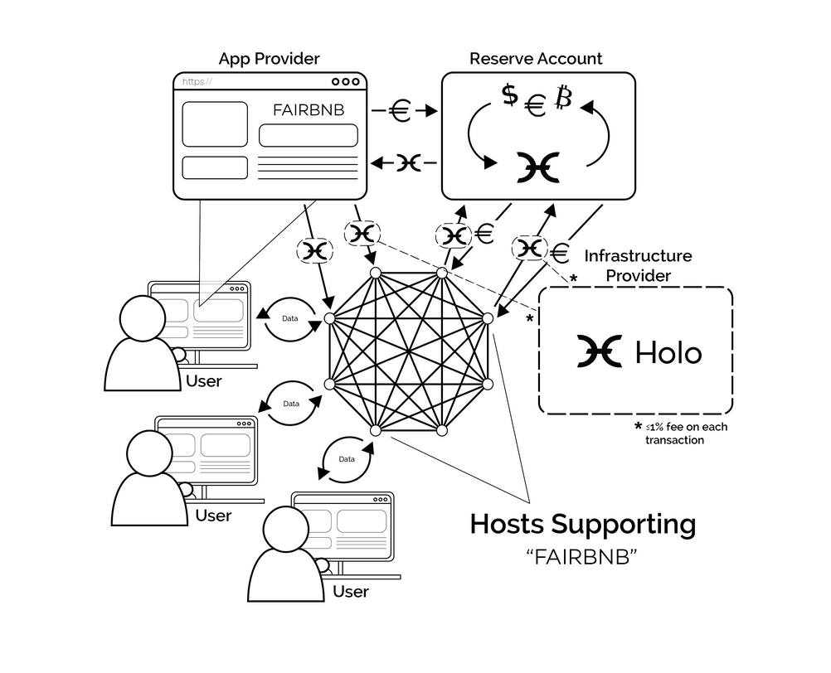
Overview of Holo Ecosystem

Slide 15
What are holochain applications best suited for?
Governance, Collaboration, and Organizational Tools
Social Networks and Social Media
Platform Cooperatives
Directly p2p sharing economy apps
Community Resource Management (the Commons)
Tokenless, mutual-credit cryptocurrencies and reputation systems
Individual controlled data collection (e.g. in the Health sphere)
Supply Chain & Open Value Networks

Slide 16
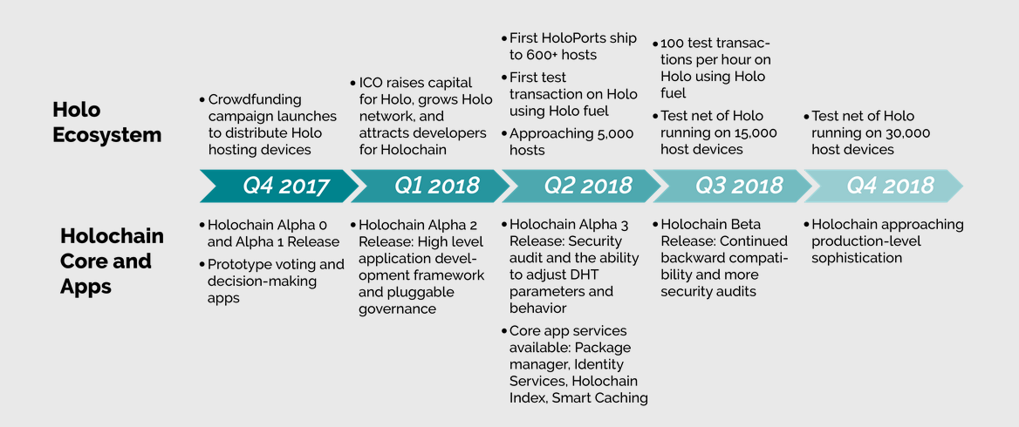
Timeline

Slide 17
Where do we go from here?
Let’s talk about it. What do you think?
How do we want to organize future meetups?
How can we co-learn?
What are you excited about?
How do you want to be involved?

Slide 18
Connect with Community
Holochain Public Mattermost Chat: https://chat.holochain.net
The Holochain Dev community is very responsive! Please ask questions here for more information about how Holochain works.
Digital Sovereignty Collective [website URL?]
facebook.com/digitalsovereigntycollective
instagram.com/digitalsovereignty/
Notes:
Add to whiteboard before we begin

Slide 19
Resources
For Developers: https://developer.holochain.org/
Github
Alpha release of holochain: bit.ly/githolochain
Current Holochain apps github.com/holochain
For Currency (Current-See) Geeks: https://medium.com/@artbrock
Papers:
holo.host/whitepapers
holochain.org/whitepaper

